Slide 1
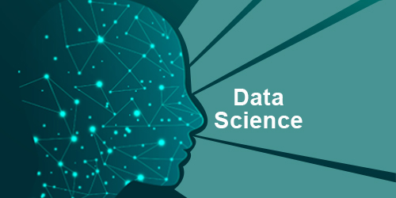
DATA SCIENCE
HARSH JAIN
harshjain997@gmail.com

Slide 2

What is data science
python basics
open Source tools for Data Science
Business understanding analytical approach
database and SQL for data science
data analysis and visualisation with python
Basic capstone project on data science using python in jupyter notebook

Slide 3
What are the prerequisites for DATA SCIENCE?
Basic Programming understanding
(oops concepts)
Data Structures and Algorithm
Basic Statistics and Probability
Database

Slide 4


Slide 5
Skills that Data Scientist Requires
Education
Data scientists are highly educated – 88% have at least a Master’s degree and 46% have PhDs – and while there are notable exceptions, a very strong educational background is usually required to develop the depth of knowledge necessary to be a data scientist.
R Programming(techinical/non-technical)
In-depth knowledge of at least one of these analytical tools, for data science R is generally preferred. R is specifically designed for data science needs.
Python Coding

Slide 6
Hadoop Platform
As a data scientist, you may encounter a situation where the volume of data you have exceeds the memory of your system or you need to send data to different servers, this is where Hadoop comes in.
SQL Database/Coding
Even though NoSQL and Hadoop have become a large component of data science, it is still expected that a candidate will be able to write and execute complex queries in SQL.
Apache Spark
Apache Spark is becoming the most popular big data technology worldwide. It is a big data computation framework just like Hadoop. The only difference is that Spark is faster than Hadoop.

Slide 7
Machine Learning and AI
A large number of data scientists are not proficient in machine learning areas and techniques. This includes neural networks, reinforcement learning, adversarial learning, etc. If you want to stand out from other data scientists, you need to know Machine learning techniques such as supervised machine learning, decision trees, logistic regression etc.
Data Visualization
Data visualization gives organizations the opportunity to work with data directly. They can quickly grasp insights that will help them to act on new business opportunities and stay ahead of competitions.
Unstructured data
Working with unstructured data helps you to unravel insights that can be useful for decision making.

Slide 8
Non Technical Skills
Intellectual curiosity
"I have no special talent. I am only passionately curious."
-Albert Einstein.
Curiosity can be defined as the desire to acquire more knowledge. As a data scientist, you need to be able to ask questions about data because data scientists spend about 80 percent of their time discovering and preparing data. This is because data science field is a field that is evolving very fast and you have to learn more to keep up with the pace.
Business
To be a data scientist you’ll need a solid understanding of the industry you’re working in, and know what business problems your company is trying to solve.

Slide 9
Communication skills
Companies searching for a strong data scientist are looking for someone who can clearly and fluently translate their technical findings to a non-technical team, such as the Marketing or Sales departments. A data scientist must enable the business to make decisions by arming them with quantified insights, in addition to understanding the needs of their non-technical colleagues in order to wrangle the data appropriately.
Teamwork
A data scientist cannot work alone. You will have to work with company executives to develop strategies, work product managers and designers to create better products, work with marketers to launch better-converting campaigns, work with client and server software developers to create data pipelines and improve workflow. You will literally have to work with everyone in the organization, including your customers.

Slide 10
THANKYOU

